Slide 1
Statistical Fundamentals
Correlation
Covariance

Slide 2
Correlation
Develop a measure of how tightly clustered a scatter diagram is about a straight line. Formally, this is called measuring linear association

Slide 3
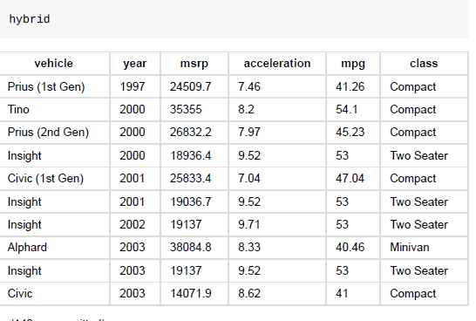
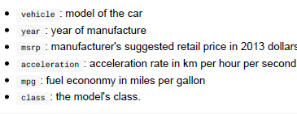
Correlation
The table hybrid contains data on hybrid passenger cars sold in the United States from 1997 to 2013.
The data adapted from the online data archive of Prof. Larry Winner of the University of Florida.

Slide 4
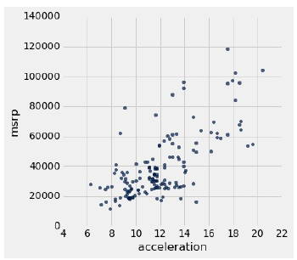
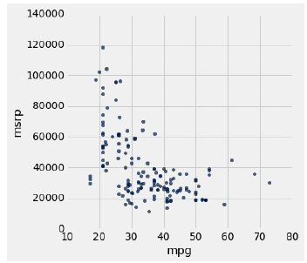
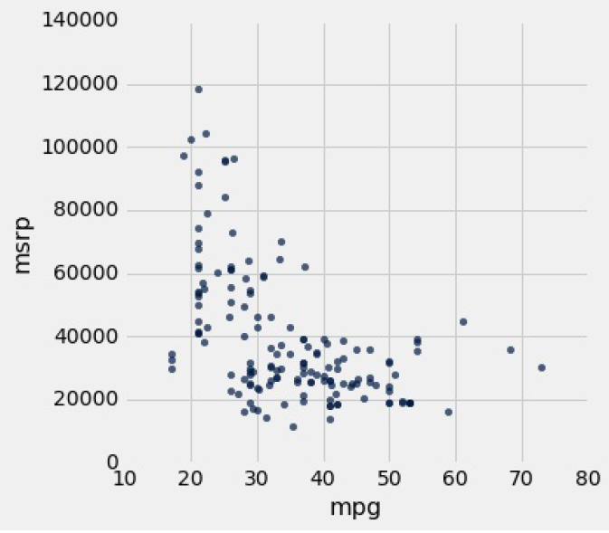
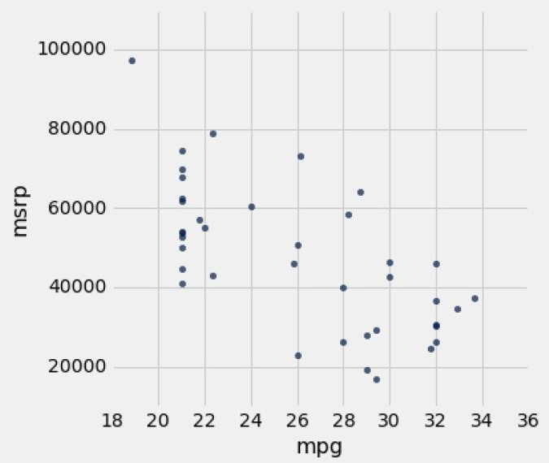
Analyse
Hybrid cars
SUV

Slide 5
Correlation
+ve; linear
-ve; non-linear
Cars with greater acceleration tended to cost more
Scatter diagram of MSRP versus mileage shows a negative association.
Hybrid cars with higher mileage tended to cost less, on average.
This seems surprising till you consider that cars that accelerate fast tend to be less fuel efficient and have lower mileage
We can derive useful information from the general orientation and shape of a scatter diagram .
This gives us a way to compare the degree of linearity in two scatter diagrams…….. plot all the variables in standard units

Slide 6
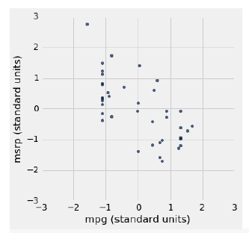
Correlation
Hybrid cars
SUV
Cost goes down with efficiency!!
Cost Vs acceleration
Non-linear association
We can derive useful information from the general orientation and shape of a scatter diagram.
To compare the degree of linearity in two scatter diagrams…….. plot all the variables in standard units

Slide 7
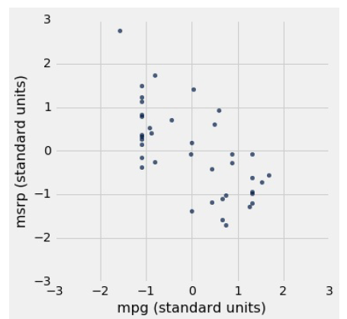
In standard units
Scatter diagrams for SUVs, with all the variables measured in standard units.

Slide 8
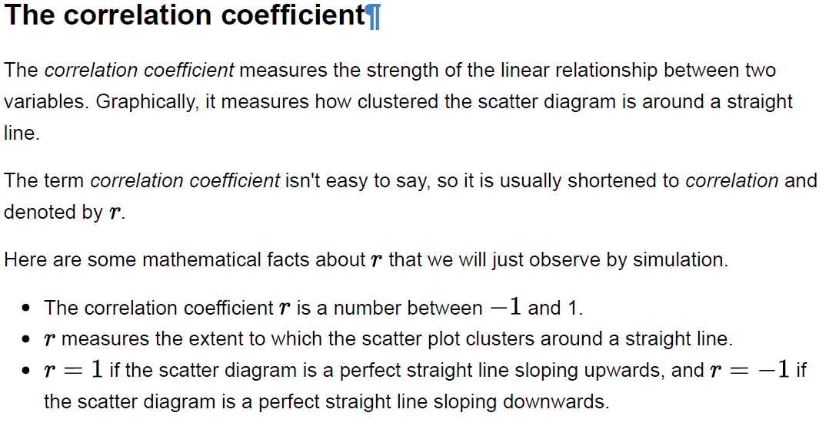
Formula for r :
r is the average of the products of the two variables, when both variables are
measured in standard units.

Slide 9
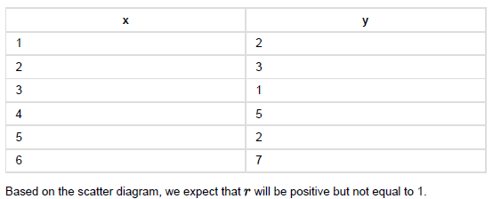
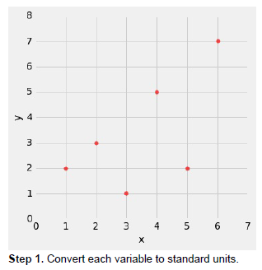
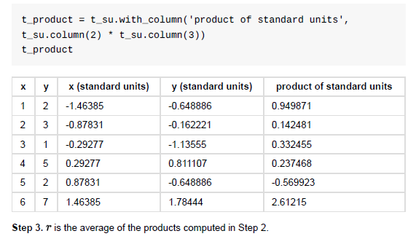
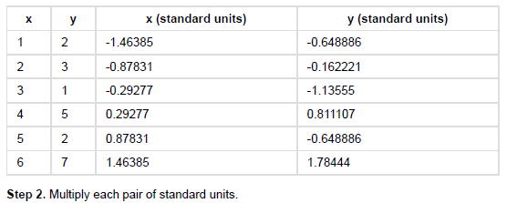
Properties of r
r (0.58 above) is a pure number. It has no units. This is because it is based on standard units.
It is unaffected by changing the units on either axis.
r is unaffected by switching the axes. Algebraically, this is because the product of standard units does not depend on which variable is on which axis.

Slide 10
Association is not Causation
Correlation only measures association. Correlation does not imply causation.
Though the correlation between the weight and the math ability of children in a school may be positive,
  that does not mean
  that doing math makes children heavier or that putting on weight improves the children's math skills.
Age is a confounding variable: older children are both heavier and better at math than younger children, on average.

Slide 11
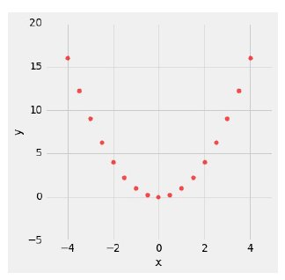
Correlation Measures Linear Association
Correlation measures only one kind of association – linear.
Variables that have strong nonlinear association might have very low correlation.
An example of variables that have a perfect quadratic relation ( y = x ² )but have correlation equal to 0.

Slide 12
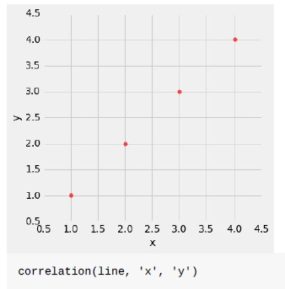
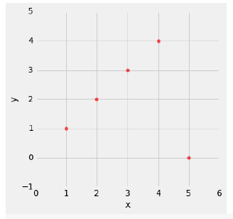
Correlation is Affected by Outliers
Outliers can have a big effect on correlation.
An example where a scatter plot for which r is equal to 1 is turned into a plot for which r is equal to 0, by the addition of just one outlying point.
Correlation =1
Correlation = 0

Slide 13
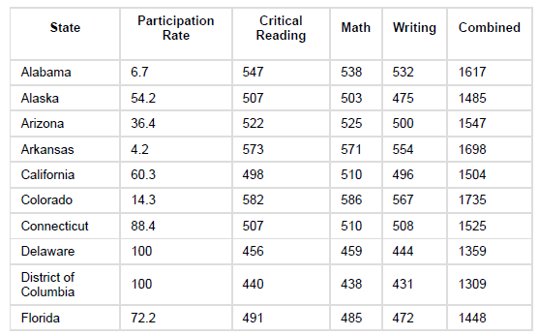
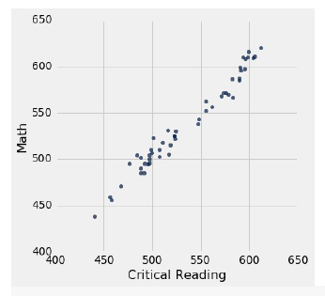
Ecological Correlations Should be Interpreted with Care
Correlations based on aggregated data can be misleading.
As an example, here are data on the Critical Reading and Math SAT scores in 2014. There is one point for each of the US states.
The column Participation Rate contains the percent of high school seniors who took the test. The next three columns show the average score in the state on each portion of the test, and the final column is the average of the total scores on the test.
That's an extremely high correlation. Is it a correct interpretation? Discuss

Slide 14
Ecological Correlations Should be Interpreted with Care
Correlations based on aggregated data can be misleading.
As an example, here are data on the Critical Reading and Math SAT scores in 2014. There is one point for each of the US states.
The column Participation Rate contains the percent of high school seniors who took the test. The next three columns show the average score in the state on each portion of the test, and the final column is the average of the total scores on the test.
That's an extremely high correlation. But it's important to note that this does not reflect the strength of the relation between the Math and Critical Reading scores of students.
Average scores is in each state…... But states don't take tests – students do

Slide 15
Difference
Covariance Vs Correlation

Slide 16
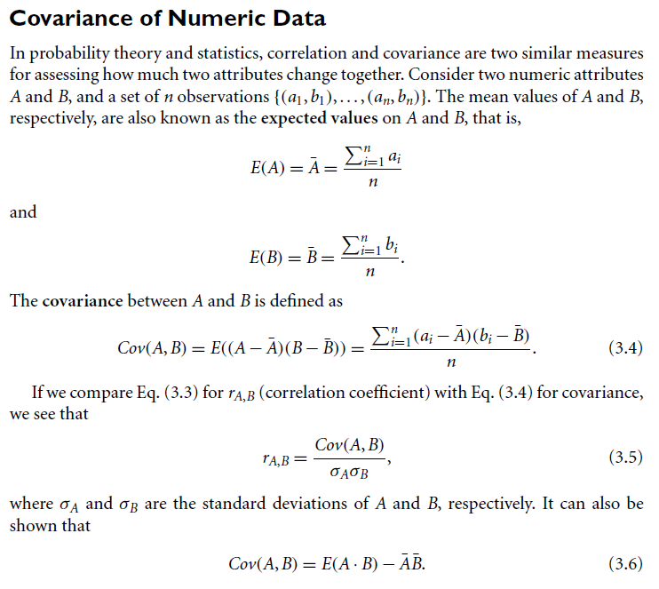

Slide 17
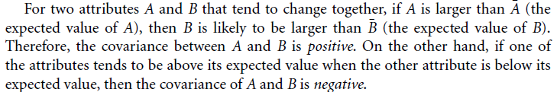
Covariance
If A and B are independent => covariance is 0. However, the converse is not true. Some pairs of random variables (attributes) may have a covariance of 0 but are not independent.

Slide 18
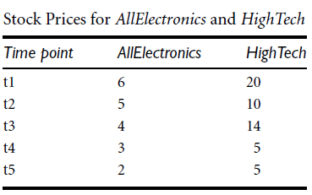
Covariance
Table presents a simplified example of stock prices observed at five time points for 2 companies: AllElectronics and HighTech, a high-tech company.
Examine if the stocks are affected by the same industry trends, will their prices rise or fall together.

Slide 19
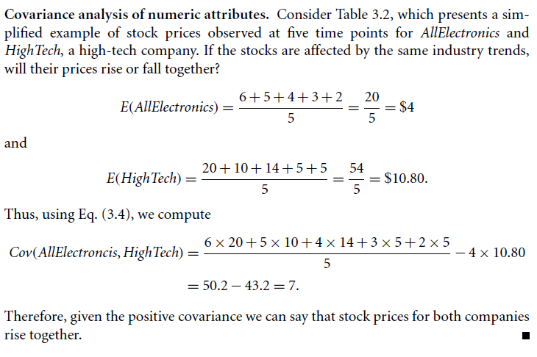
Covariance
NB: Variance is a special case of covariance, where the two attributes are identical (i.e., the covariance of an attribute with itself).

Slide 20
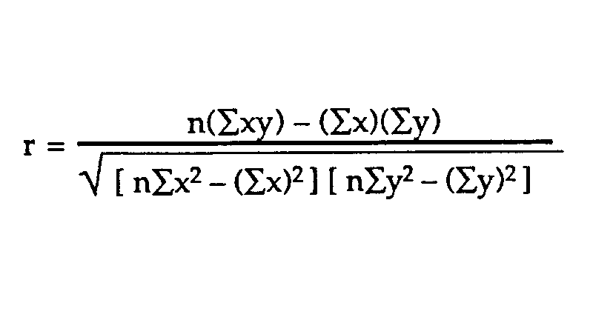
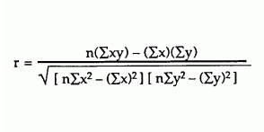

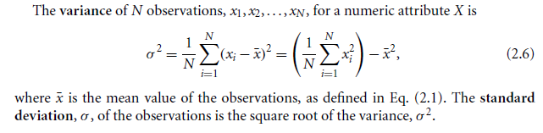
Pearson Correlation Coefficient
SUBJECT | AGE X | GLUCOSE LEVEL Y
1 | 43 | 99
2 | 21 | 65
3 | 25 | 79
4 | 42 | 75
5 | 57 | 87
6 | 59 | 81
Is there any correlation between Age and Glucose Levels?

Slide 21
Pearson Correlation Coefficient
SUBJECT | AGE X | GLUCOSE LEVEL Y
1 | 43 | 99
2 | 21 | 65
3 | 25 | 79
4 | 42 | 75
5 | 57 | 87
6 | 59 | 81
Σx = 247
Σy = 486
Σxy = 20,485
Σx² = 11,409
Σy² = 40,022
n is the sample size, in our case = 6
The correlation coefficient =
6(20,485) – (247 × 486) / [√[[6(11,409) – (247²)] × [6(40,022) – 486²]]]
The answer is: 2868 / 5413.27 = 0.529809

Slide 22
Measuring the Dispersion of Data Five-Number Summary, Boxplots, and Outliers
No single numeric measure of spread (e.g., IQR) useful for describing skewed
distributions.
In the symmetric distribution, the median (and other measures of central tendency)
splits the data into equal-size halves. This does not occur for skewed distributions.
Therefore, it is more informative to also provide the two quartiles Q1 and Q3, along
with the median.
A common rule of thumb for identifying suspected outliers is to single out values falling at least 1.5IQR above the third quartile or below the first quartile.
The five-number summary of a distribution (min, Q1, Q2, Q3 and max).
  Q1, the median, and Q3 contain no information about the endpoints (e.g., tails).
  For a fuller summary of the shape of a distribution=> give the lowest and highest data.
NB: Boxplots are a popular way of visualizing a distribution.

Slide 23
Summary……
Measuring the Dispersion of Data
Quartiles, outliers and boxplots
  Quartiles: Q₁ (25th percentile), Q₃ (75th percentile)
  Inter-quartile range: IQR = Q₃ – Q₁
  Five number summary: min, Q₁, M, Q₃, max
  Boxplot: ends of the box are the quartiles, median is marked, whiskers, and plot outlier individually
  Outlier: usually, a value higher/lower than 1.5 x IQR
Variance and standard deviation (sample: s, population: σ)
  Variance: (algebraic, scalable computation)
  Standard deviation s (or σ) is the square root of variance s² ⁽or σ²⁾

Slide 24
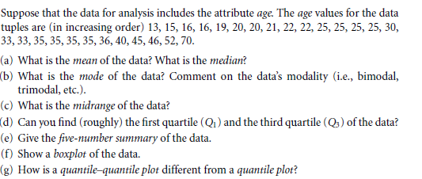
Ex

Slide 25
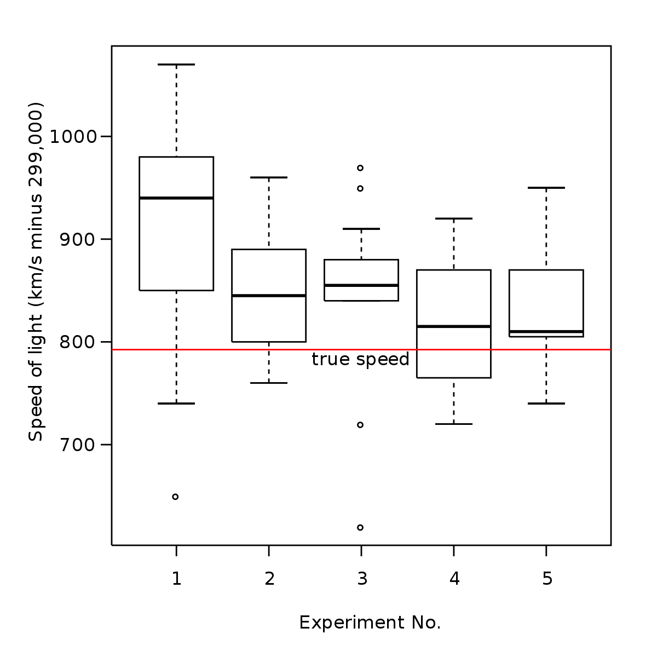
Box Plots

Slide 26
Measuring the Dispersion of Data
Measures to assess the dispersion or spread of numeric data:
  range,
  quantiles,
  quartiles,
  percentiles, and the
  interquartile range.
Five-number summary, which can be displayed as a boxplot, is useful in identifying outliers.
Variance and standard deviation also indicate the spread of a data distribution.

